Slide 1

DEPARTMENT OF CSE (ARTIFICIAL INTELLIGENCE AND MACHINE LEARNING) ACADEMIC YEAR 2025 - 2026 SEMESTER IV MACHINE LEARNING LABORATORY MINI PROJECT REVIEW STUDENT PERFORMANCE PREDICTION SYSTEM
REGISTER NUMBER | 2117240030045
NAME | HARSHINI J
YEAR | II
SECTION | A
FACULTY IN-CHARGE | Mrs. M. Divya

Slide 2
PROBLEM STATEMENT
Traditional student evaluation methods mainly depend on examination marks, assignments, and manual assessment.
These methods may not accurately identify weak or low-performing students at an early stage.
Student performance is influenced by several factors such as study hours, attendance percentage, subject scores, age, and internet usage.
Analyzing all these factors manually can be difficult, time-consuming, and less efficient.
Without early prediction, students may miss the chance to improve their academic performance on time.
Teachers and institutions need a smart system to monitor student progress effectively.
Therefore, a machine learning-based prediction system is required to forecast student grades and provide timely support and recommendations.

Slide 3
THEORETICAL BACKGROUND
Machine Learning is a branch of Artificial Intelligence that enables systems to learn from data and make predictions automatically.
It uses historical data to identify patterns and generate accurate future results.
In the education sector, Machine Learning is used to analyze student records and predict academic performance.
Student performance depends on several factors such as study hours, attendance percentage, subject scores, age, and internet usage.
This project uses the Random Forest Classifier, which is a supervised learning algorithm used for classification tasks.
Random Forest creates multiple decision trees during training and combines their outputs using majority voting.
This method improves prediction accuracy and reduces overfitting compared to a single Decision Tree.
The system predicts student grades such as A, B, C, and D based on the given input data.
It also helps teachers identify weak students early and provide timely academic support.

Slide 4
THEORETICAL BACKGROUND
Load student dataset (age, study hours, attendance, subject scores).
Preprocess data and create new feature (internet usage + overall score).
Assign grade based on overall score (A, B, C, D) and encode labels.
Select input features and target variable.
Split data into training (80%) and testing (20%) sets.
Train Random Forest Classifier model.
Take user input and predict student grade.
Evaluate model using accuracy, precision, recall, F1-score, and confusion matrix.
Display prediction results with graphs and recommendations.
Deploy interactive dashboard using Streamlit for real-time prediction.
Visualize feature importance to understand key factors affecting performance.
Generate correlation heatmap to analyze relationships between variables.
Provide personalized academic recommendations based on prediction results.
Improve model performance using multiple decision trees (ensemble learning).
Ensure real-time user interaction through Streamlit web application.
ALGORITHM

Slide 5
IMPLEMENTATION AND CODE
Link to code in Git-hub Repository
report
Git Hub Link of the project and report
https://github.com/HarshiniJayakumar/Harshini-J_ML_Mini_Project

Slide 6
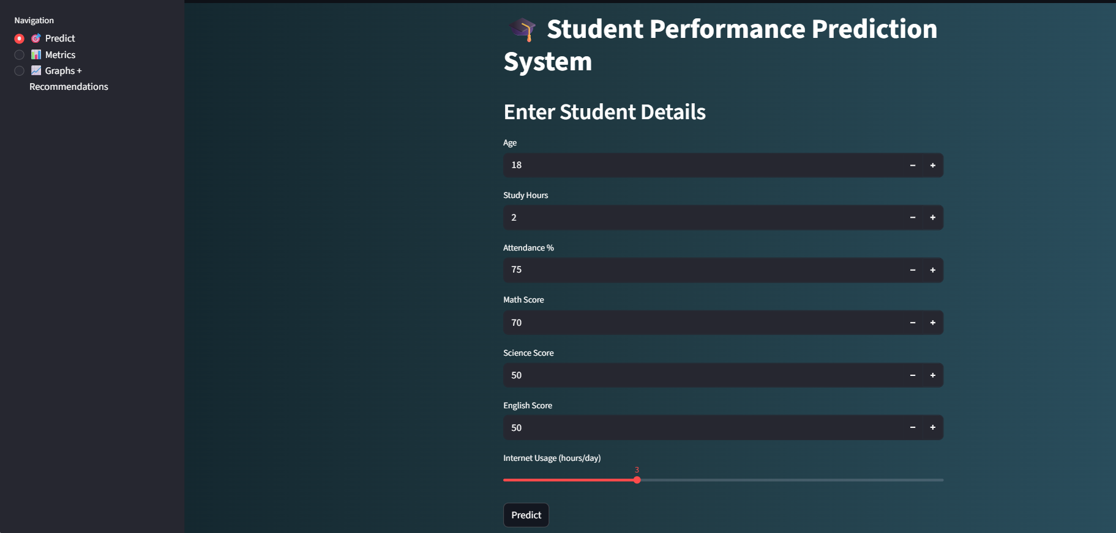
OUTPUT AND RESULTS
The input interface is the interactive Streamlit dashboard where users enter student details such as age, study hours, attendance, and subject scores. It allows real-time data input and instantly displays the predicted performance results along with confidence score and recommendations.

Slide 7
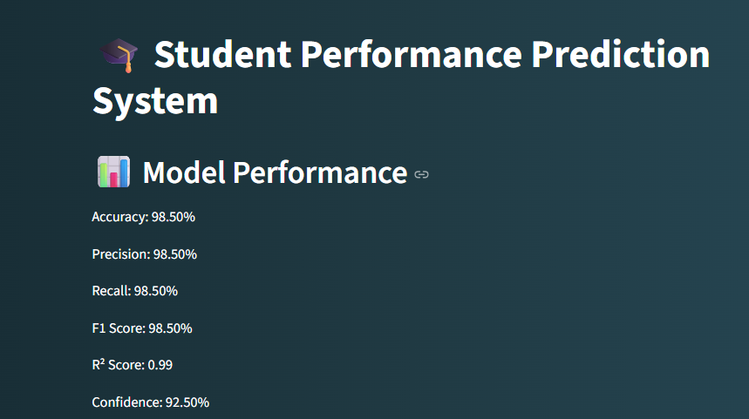
OUTPUT AND RESULTS
The metrics dashboard displays the performance of the machine learning model using evaluation measures such as accuracy, precision, recall, F1-score, R² score, and confusion matrix. It helps to understand how well the model is predicting student performance.

Slide 8
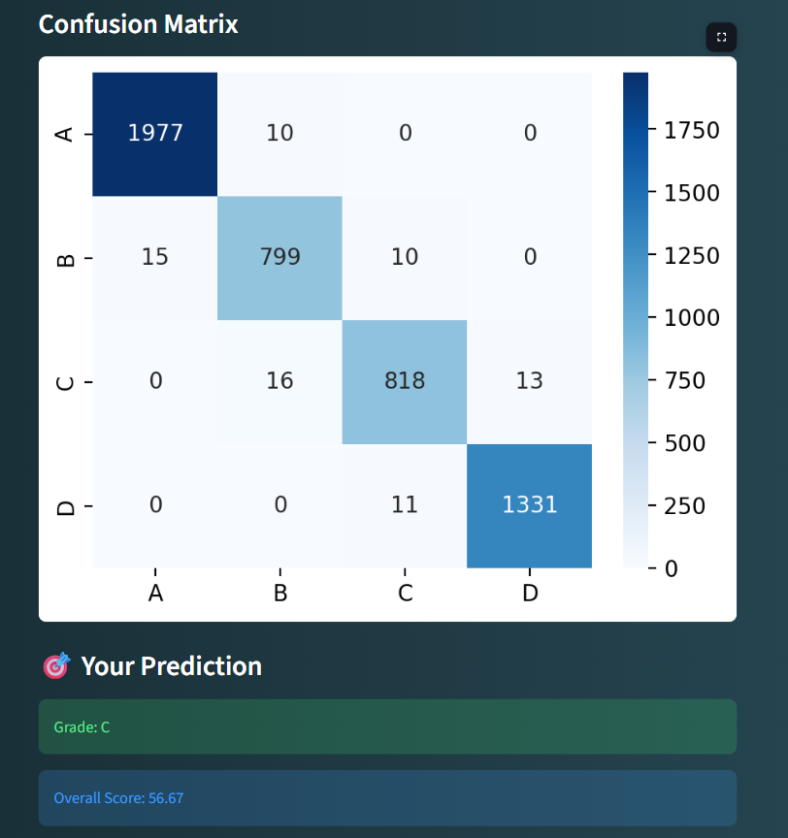
OUTPUT AND RESULTS
The confusion matrix shows the number of correct and incorrect predictions made by the model for each grade category (A, B, C, D), helping to evaluate classification performance.
The prediction section displays the final output grade for a student based on input features along with the overall score.

Slide 9
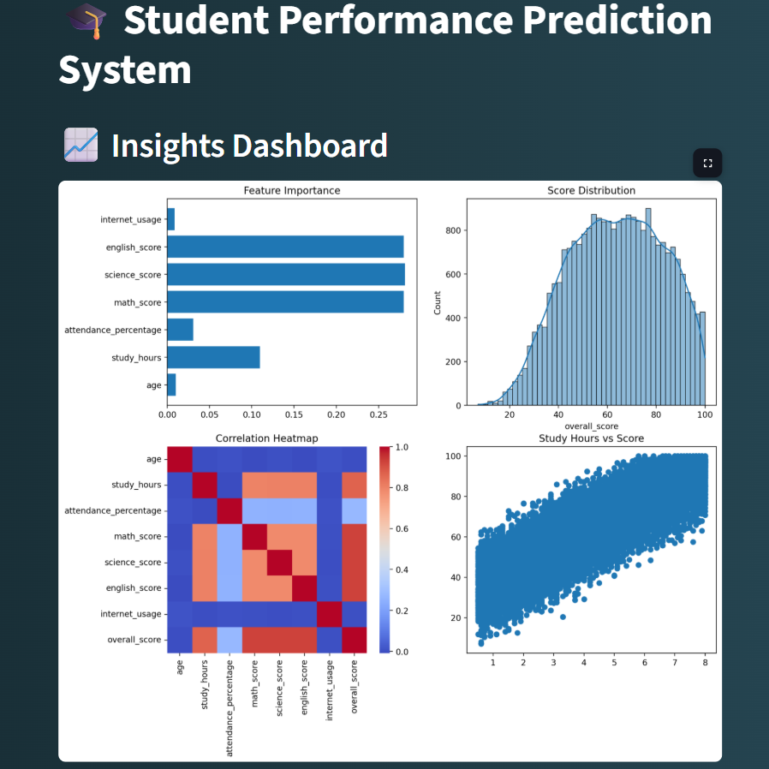

OUTPUT AND RESULTS
Modern visualization shows data insights using simple graphs like bar charts, heatmaps, and scatter plots to understand student performance.
Recommendations give easy tips to students like improving study time, maintaining attendance, and focusing on weak subjects.

Slide 10
OUTPUT AND RESULTS
The system successfully predicts student performance as grades (A, B, C, D).
The Random Forest Classifier provides reliable and stable prediction results.
Key factors such as study hours, attendance percentage, and subject scores significantly impact performance.
The Streamlit dashboard enables real-time user interaction and instant prediction.
Data visualizations (graphs and heatmaps) help in better understanding student behavior patterns.
The model evaluation shows good performance using accuracy, precision, recall, and F1-score.
Users receive immediate predicted grade along with confidence score and insights.
Results

Slide 11
OUTPUT AND RESULTS
Improve model performance using advanced algorithms like XGBoost, SVM, or Neural Networks.
Include additional features such as student behavior, assignments, and extracurricular activities.
Integrate real-time data collection from school or college management systems.
Deploy the application on cloud platforms like AWS, Azure, or Streamlit Cloud for wider access.
Add a student login system with personalized dashboards and progress tracking.
Introduce AI-based personalized learning recommendations for each student.
Expand system to predict semester-wise or year-wise academic performance trends.
Future enhancements

Slide 12
REFERENCES
Kaggle Dataset – https://www.kaggle.com/datasets Used for student performance data collection.
Scikit-learn Documentation – https://scikit-learn.org/stable/ Used for implementing machine learning models.
Streamlit Documentation – https://docs.streamlit.io/ Used for building the web application.
Python Documentation – https://docs.python.org/3/ Used for Python programming reference.
GeeksforGeeks (Machine Learning) – https://www.geeksforgeeks.org/machine-learning/ Used for understanding ML algorithms and concepts.
Towards Data Science – https://towardsdatascience.com/ Used for learning real-world machine learning applications and ideas.
Analytics Vidhya – https://www.analyticsvidhya.com/ Used for understanding feature engineering and model evaluation techniques.

